Slide 1
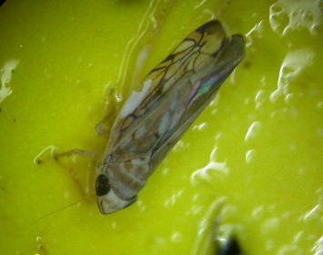
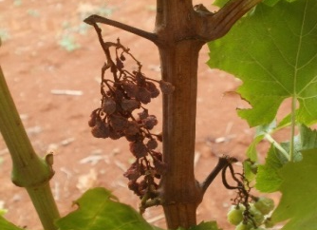
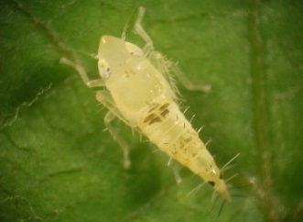
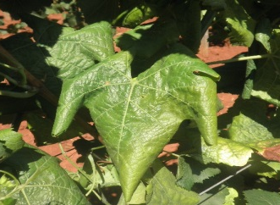
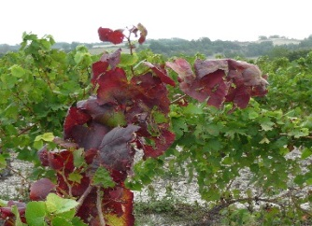
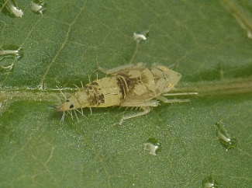
Suzbijanje i sprječavanje širenja zlatne žutice vinove loze

Slide 2
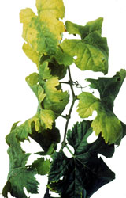
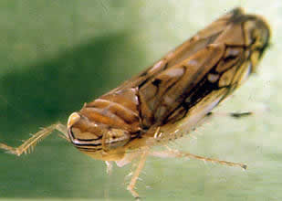
Uvod
Zlatna žutica je po prvi put detektirana 1950-tih godina u Francuskoj
Zaražene trsove je nemoguće izliječiti
Nalazi se na A2 EPPO listi
Za njeno širenje potrebno je istovremena prisutnost fitoplazme (uzročnika bolesti), vektora (američkog cvrčka) i domaćina (loze)
→ U slučaju izostanka suzbijanja, moguće
je njeno brzo širenje, znatni gubici prinosa
te čak propadanje čitavih vinograda
Notes:
The disease, caused by a phytoplasma, which is a quarantined organisms indexed on the A2 EPPO list (n°2009/297CE directive) is one of the most damaging diseases in the European vineyard, with strong economic consequences in the major wine-producing countries. The main known vector of FD is a leafhopper strictly associated with grapevine, who transmits the phytoplasma. FD induce severe impacts, including yield losses and vine plant dieback. Without control measures, the disease spreads rapidly, affecting up to the totality of vines in a few years. Despite mandatory control in Europe for this disease, it is still spreading and requires permanent monitoring to detect new infected areas.

Slide 3
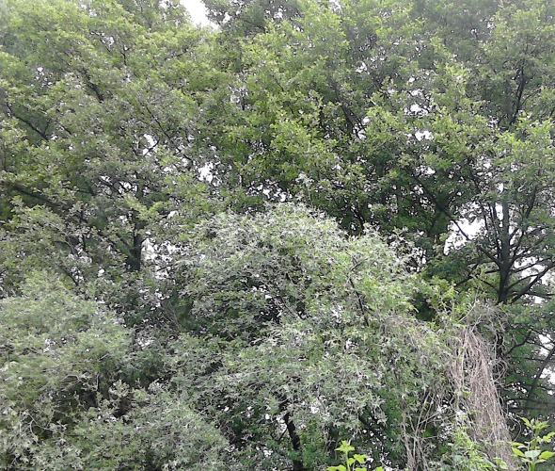
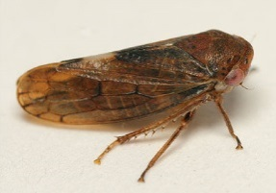
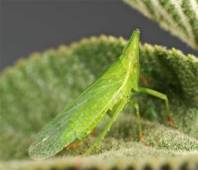
Širenje zlatne žutice
Zlatna žutica se može prenositi s drugih biljnih vrsta na vinovu lozu
Glavni vektor koji prenosi bolest: američki cvrčak (Scaphoideus titanus), koji potječe iz Sjeverne Amerike
Uzročnici fitoplazme:
FD1, FD2 i FD3
Mogući načini širenja
Oncopsis Alni
©Tristan Bantock
Dictyophara europaea
© Dimitri Geystor
Scaphoïdeus titanus
Vitis vinifera
Clematis vitalba i Alnus glutinosa
(obična pavitina i crna joha)
Notes:
FD main known vector, Scaphoideus titanus, was introduced in Europe from North America in the 1950’s. Its introduction was attributed to vine plant introduction from North America.

Slide 4
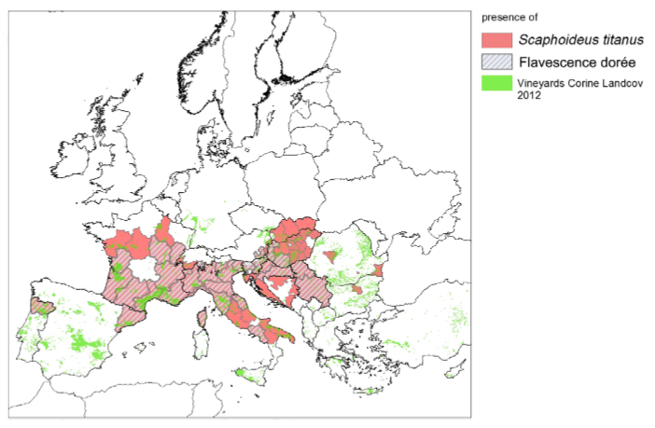
Širenje zlatne žutice
Fitoplazma koja uzrokuje zlatnu žuticu izvorno potječe iz Europe
Američki cvrčak kao vektor zlatne žutice izvorno potječe iz Sjeverne Amerike
→ Područje distribucije američkog cvrčka šire je od područja distribucije zlatne žutice
© EFSA
Notes:
S.titanus may have already been present in 1927, but at such small spatial scale and population level that is was not recorded in inventories. The invasion of European vineyards by S. titanus is an ongoing process, the insect extended from France to most European vineyards and is now widely present in winegrowing regions from West to East from Portugal to Serbia and from North of France to South of Italy. Distribution of S. titanus in Europe is wider than the phytoplasma, insect is present in regions so far safe from FD (e.g. North of Spain or Alsace region in France). The first FD outbreak was detected in France in 1957, and then disease spreads rapidly to other European wine regions. Today the Flavescence Dorée phytoplasma is present the main wine-producing countries in Europe, namely Austria, Croatia, France, Hungary, Italy, Portugal, Slovenia and Spain Switzerland and Serbia. In some of these countries, the phytoplasma is limited to some geographical areas. The spread of the disease in Europe is strongly linked to the spread of Scaphoideus titanus, mainly based on the dispersion of introduced populations and linked to human activities. The spread of Scaphoideus titanus might not be yet ended: populations of S. titanus could become established in northern Europe or China because of favourable climatic conditions of those areas.

Slide 5
Simptomi
U početku vegetacije
Kasno otvaranje pupova
Izostanak otvaranja pupova
Na proljeće
Smanjen porast mladica
Promjena boje lista i savijanje ruba lista kod nekih sorata
Ljeti
Izostanak odrvenjavanja mladica (ostaju zeljaste)
Sušenje (odumiranje) cvatova i grozdova
Prerano opadanje listova
Notes:
Grapevine infected with FD, develops symptoms that are not distinguishable from other grapevine phytoplasmas that belong into the group of grapevine yellows (GY).
Once affected by FD, grapevine shows symptoms characteristics of grapevine yellows. Early vine stages: first visible symptom can be either a delay or lack of budburst, but such observations have always to be completed later by monitoring of typical FD symptoms in summer.
In spring: symptoms of reduced growth of fruiting cane, leaf blade light curling and premature leaf fall can be observed but the more evident symptoms appear later.
In september: On infected grapevine, a lack or absence of lignification in the new shoots can be observed, with leaves curling downwards, cracking when folded in hand, and becoming reddish for red cultivars or yellowish for white cultivars. Desiccation of inflorescences and berries is observed and a premature leaf fall due to limb detachment from petiole can also occur in summer. Inside the plant, phytoplasma reduces photosynthetic activity and nutrient transport, decreasing grape quality or even causing total desiccation of bunches, involving significant yield losses (up to 100%).

Slide 6
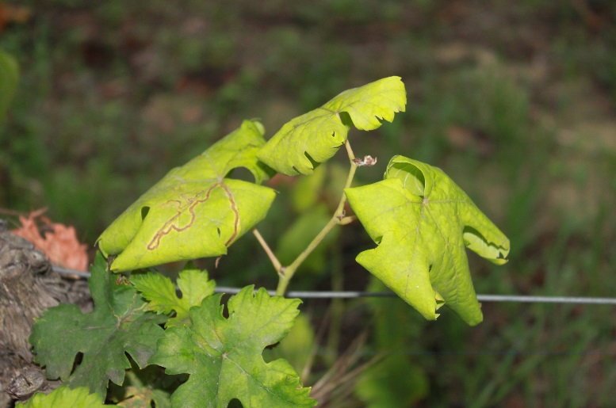
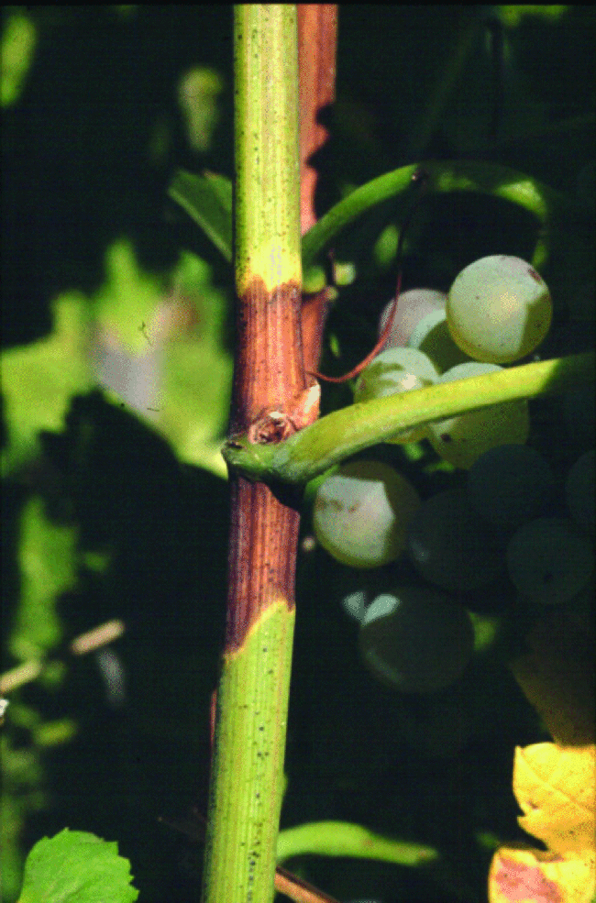
Simptomi
U slučaju sumnje na zlatnu žuticu:
Provjerite javljaju li se na trsu istovremeno sljedeća tri simptoma:
Promjena boje listova (i eventualno uvijanje ruba lista)
Izostanak odrvenjavanja mladica
©Canadian Food Inspection Agency
Sušenje cvatova ili grozdova
Notes:
FD symptoms can be confused with other symptoms, as deficiencies or physiological disorders.
In any case of doubt, the presence of the three typical symptoms (leaf discoloration and curling, no lignification of the shoots and desiccation of bunches) must be checked

Slide 7
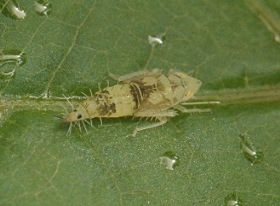
Simptomi
→ Ovisno o sorti, simptomi mogu biti više ili manje izraženi
→ Zaražene podloge mogu biti bez pojave simptoma
Simptomi zlatne žutice ne razlikuju se od simptoma ostalih fitoplazmi vinove loze
→ U slučaju sumnje na zlatnu žuticu, provodi se PCR analiza s ciljem identifikacije fitoplazme
Notes:
Symptoms can be more or less visible according to the cultivar, furthermore, rootstocks are asymptomatic (healthy carriers of FD phytoplasma).
Then laboratory analysis can be performed if a doubt subsists for a FD case. As FD symptoms are similar to Stolbur symptoms, a PCR analysis can determine which phytoplasma is responsible for the observed symptoms. PCR method allow to diagnose and identify phytoplasma inside grapevine organs (leaf blade and petiole) by analysing DNA fragment

Slide 8
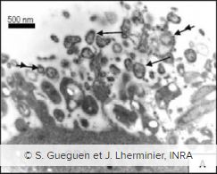
Tri čimbenika potrebna za širenje zlatne žutice
Uzročnik bolesti: fitoplazme skupine FD1, FD2 ili FD3
Fitoplazma je mikroorganizam sličan bakteriji, nema staničnu stijenku i nastanjuje floem biljke → prenosi se vektorom ili reznicama
3 skupine fitoplazmi uzrokuju zlatnu žuticu:
FD1 – najzastupljenija na jugu Francuske
FD2 – glavna skupina u Europi
FD3 – prisutna uglavnom u Italiji
Ostale biljne vrste domaćini: obična pavitina i crna joha
Fitoplazma
Notes:
The phytoplasma causing FD show genetic diversity: several phytoplasma strains can cause FD and are distributed throughout Europe. Till now, 3 genetics groups of FD phytoplasma are identified in Europe
Host-plants can serve as phytoplasma reservoirs, as Alnus glutinosa, Clematis vitalba and wild Vitis species. In Europe, the mainly accepted hypothesis is that those FD-related phytoplasma were hosted in those plants prior to grapevine.

Slide 9
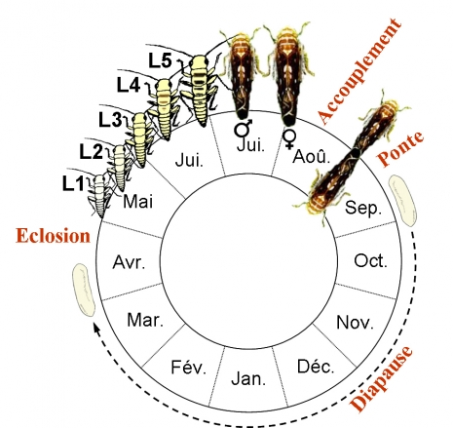
Tri čimbenika potrebna za širenje zlatne žutice
2) Vektor: američki cvrčak (Scaphoideus titanus )
Životni ciklus
Jedna generacija godišnje
Ličinke obično ostaju na trsu nakon izlaska iz jajeta
Odrasli oblici su mobilni i lete s trsa na trs
Parenje
Leženje jaja
Izlazak iz jajeta
Mirovanje
©Cuche
Notes:
Scaphoideus titanus is a univoltine species.
Eggs are laid in late summer under the bark of old wood, then after a diapause stage of 6 to 8 month depending on climatic conditions and vineyard characteristics, eggs hatch. Hatching period duration is related to diapause, which does not require cold temperatures to break.
Hatching period duration is varying according to the regions and long hatching periods are typical of vineyards with mild winters. Temperatures regulate the beginning and the length of hatching period as well as the sex ratio. After hatching, 5 nymphal instars follow each other in 5 to 8 weeks according to climatic conditions before adult appearance. Nymphs usually stay on the plant where they hatch but sometimes jump from one plant to another. They feed preferentially on suckers at the basis of the trunk or on the lower and inner leaves. Adults appear generally from July, are highly mobiles and fly from vine to vine. In order to mate, Scaphoideus titanus emits vibratory communication signals. Females, if mated, are able to start laying eggs 10 days after emergence (maturity at 6 days after emergence).

Slide 10
Tri čimbenika potrebna za širenje zlatne žutice
2) Vektor: američki cvrčak (Scaphoideus titanus )
Hranjenje
Ima usni ustroj za bodenje i sisanje i hrani se na listu loze
Usvajanje fitoplazme u tijelo američkog cvrčka moguće je od prvog razvojnog stadija ličinke
Zatim slijedi period inkubacije koji traje mjesec dana, nakon čega je cvrčak infektivan do kraja života
Notes:
Scaphoideus titanus feeds on grapevine leaves. It is generally admitted that Scaphoideus titanus is mostly feeding in the phloem vessels, but it can probe sap either in the phloem or in the xylem. Nymph prefer to feed on small veins of the leaf blade and adults feed more on the larger veins or petioles. From the first nymphal instar, S. titanus can acquire the phytoplasma when feeding on infected plants, and then remain infected for the rest of its life. An incubation delay of one month is required for the vector to become infectious. During this period the phytoplasma circulates and multiplies in the leafhopper to reach the salivary glands where multiplication rate is even higher. Once the concentration of phytoplasma in the salivary glands is sufficient, the infectious agent may be transmitted to a healthy plant for every intake.

Slide 11
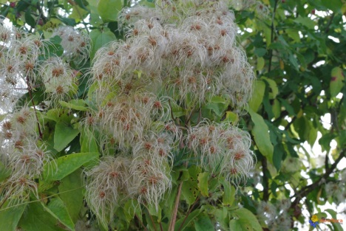
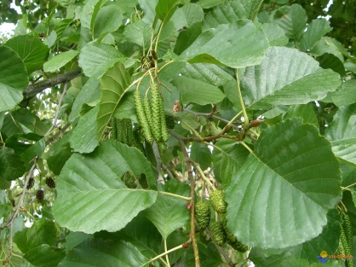
Tri čimbenika potrebna za širenje zlatne žutice
3) Biljka domaćin: vinova loza i ostale vrsta loza
Američki cvrčak može svoj cjelokupni životni ciklus dovršiti jedino na vinovoj lozi
→ zlatna žutica je bolest koja se širi epidemijski
Zlatna žutica je prisutna i na drugim biljnim vrstama: Clematis vitalba (obična pavitina) i Alnus glutinosa (crna joha)
→ I ostali vektori mogu prenositi zlatnu žuticu (Oncopsis alni i Dictyophara europaea), ali je takvo širenje od minornog značaja.
Oncopsis alni
©Tristan Bantock
Dictyophara europaea
© Dimitri Geystor
Clématis vitalba
© Visoflora
Alnus glutinosa
© Visoflora
Notes:
In Europe, S. titanus is strongly associated to Vitis vinifera but can be occasionally found on other plants as Salix viminalis and Prunus persica. The insect accomplish its entire life cycle on grapevine but can occasionally feed on other plants. S. titanus could have varietal preferences: in multivarietal vineyard different population level were observed on each variety.
S. titanus is associated to grapevine but FD phytoplasma can be found in other species as Alnus glutinosa, Clematis vitalba, Ailanthus altissima... Other vector species, as the planthopper Dictyophara europaea and the leafhopper Oncopsis alni, can transmit the phytoplasma from these species to grapevine. But this phenomenon seems very occasional, then transmission probability is low as these vectors are very rare feeders on grapevine unlike S. titanus
When a vine plant is infected, phytoplasma colonizes all the parts of the plant via the phloem and constitutes therefore a source of infection. By feeding on grapevine and moving from grapevine to grapevine, S. titanus spread the disease. Therefore, the infection rate in year N is strongly correlated to vector populations in year N-1. Without insecticide treatment, S. titanus populations in vineyard can reach a magnitude range of thousands of individuals per hectare leading to a fast spread of the disease, with an increasing number of infected vines up to 10-fold every year!

Slide 12
Suzbijanje vektora (američkog cvrčka)
Strategija tretiranja:
- Korištenje insekticida → smanjuje populaciju vektora
- Tretiranje u pravi trenutak → regulirano Naredbom o suzbijanju
Prvo tretiranje obavlja se mjesec dana nakon izlaska ličinki iz jaja (nakon cvatnje, u prvoj polovici lipnja)
Drugo tretiranje obavlja se dva do tri tjedna nakon prvog tretiranja
Treće tretiranje obavlja se krajem srpnja ili početkom kolovoza (samo) ako se tijekom srpnja ulovi tjedno četiri ili više odraslih oblika vektora po jednoj žutoj ljepljivoj ploči
May
Jun
Jul
Aug
Apr
Sep
Izlazak iz jaja
T1
T2
T3
Strategija suzbijanja s
tri tretiranja
Jaja
Ličinke
Odrasli oblici
Notes:
Insecticides treatments targeting Scaphoideus titanus are essential to decrease vector populations and then decrease the speed and/or risk of FD outbreak. To be efficient and because Scaphoideus titanus is a very powerful and efficient insect to spread FD in the vineyard, insecticides treatments must be applied at the right moment.
The good timing and number of insecticides treatments is defined by national decree as a result of quarantine status of FD.
The date of first mandatory treatment is usually determined by special organisation.
To determine this date, emerging cages can be used and at least a monitoring of first nymphal stage is done on control plots. Emerging cages contain 2 years old wood from an infected plot the year before and a sticky trap. When eggs present under bark hatch, nymphs are stuck on the sticky trap. The date of observation of first eggs is registered and then confirmed few days later in the field.
The first insecticide treatment is positioned one month after the first hatching.
The second treatment can be positioned either at the end of remanence of the first treatment (1 week in organic production and until 3 weeks in conventional production) with the objective to cover end of hatching in the area where S. titanus population is high or on adults in areas where S. titanus population is low .
According to the regions and even to the area within a same region a third treatment can be applied or not. This is determined by decree according to FD history of the area. Furthermore, a monitoring on adults could help to determine if a third treatment should be applied. A high frequency of vector adults mean that contamination risk is high and an additional treatment should/must be applied.

Slide 13
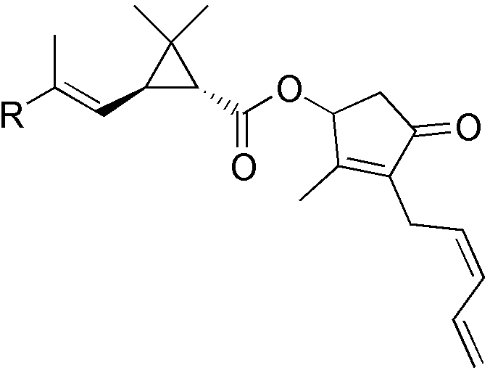
Suzbijanje vektora (američkog cvrčka)
Strategija tretiranja u ekološkoj poljoprivredi:
- Potrebno je provoditi temeljiti monitoring vektora
- Efikasnost suzbijanja je ograničena → dozvoljena sredstva su osjetljiva na visoke temperature i UV zračenje
- U EU se koriste prirodni piretrin i azadiraktin
- Imaju kontaktno djelovanje
© Wikipédia
Notes:
In organic viticulture, prevention is crucial, Scaphoideus titanus presence in the plot needs to be monitored and with much precision, especially when the plot is close to an area where the presence of FD has been confirmed. In addition, insecticides treatments against FD vector are performed in some European countries. They are based on natural pyrethrum and Azadirachtin (EC Reg. 889/08).
These active ingredients are delicate and should be applied with high precision and respecting certain specific requirements, otherwise their efficacy (especially pyrethrum) is limited. In addition to insecticide treatments that have to be regularly renewed, scheduled observations of the vineyard are essential to prevent FD spreading. Any symptomatic grapevine must to be uprooted immediately in order to contain the disease.
The effect of pyrethrum: Natural pyrethrum is a delicate molecule, sensitive to high temperatures and UV radiations. Half-life time is estimated to 10-12 minutes for a pyrethrum solution directly exposed to sun. Product has a “shock action” by contact and acts on insect nerve conduction. Application of natural pyrethrum can be performed in association with copper or sulphur application. Natural pyrethrum is effective on L1 to L3 stages of S.titanus. Unfortunately, efficiency of pyrethrum treatment is variable and serious monitoring of vector populations and several successive observations of the plot are required, before and after treatment with pyrethrum-based chemical specialities.

Slide 14
Monitoring zlatne žutice
Nova zaraza zlatnom žuticom u području koje još nije zaraženo može se spriječiti suzbijanjem potencijalnih izvora zaraze:
Potencijalni izvori zaraze: divlja loza, zapušteni trsovi i ostale biljne vrste poput obične pavitine i crne johe:
Ove biljke predstavljaju rizik epidemijskog širenja
Također su važne u smislu očuvanja bioraznolikosti ekosustava
→ Djelovati u skladu sa situacijom i procjenom rizika
Notes:
Wild vines and other species represent a reservoir for Scaphoideus titanus, and for FD phytoplasma. FD phytoplasma has been reported on wild species as Clematis and Alnus and may be transmitted occasionally to grapevine.
This so-called “wild compartment” thus presents a known risk of epidemic emergences. However, he could also supply services at the vineyard: reservoir of biodiversity, natural regulation of some pests by auxiliaries. Thus, it’s important to consider and estimate the relationships between epidemic risk and services of natural regulation which offer these semi-natural areas. So, beyond the perimeter of the vineyard itself, the extension of the monitoring and disease control in these wild compartments is not easy.

Slide 15
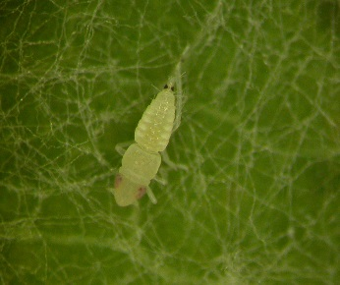
Monitoring zlatne žutice
Prepoznavanje američkog cvrčka
Ima dvije simetrične crne točke na dorzo-lateralnoj poziciji
Stadiji razvoja ličinke: L1 (lijevo), L3 (u sredini) i L5 (desno)
Odrasli oblik:
Smeđe je boje
Duljine od 4,8 do 5,8 mm
Scaphoideus titanus
Notes:
Scaphoideus titanus is hard to detect and to recognize, because nymphs are small and mobiles.
Furthermore, the leafhopper can be confused with other leafhoppers or insects living on grapevine.
Early stages of S.titanus nymphs are first white colour to translucent, and then stain with ageing. Nymphs are identifiable thanks to two symmetrical black points in dorsolateral position near abdomen posterior end. Nymphs, when disturbed, show a typical behaviour: they tend to jump away. This behaviour can be used to discriminate S.titanus nymphs from other leafhopper juvenile forms that should be present at the same time on the grapevine leaves, such as Empoasca vitis (when disturbed moves laterally on the leaf surface) and Zygina rhamni (when disturbed show to move along a straight line on the leaf surface).
Scaphoideus titanus adult size range from 4,8 to 5,8 mm, has brown colour and stripes on the head.

Slide 16
Monitoring zlatne žutice
Prepoznavanje američkog cvrčka
S ponešto iskustva američkog cvrčka je moguće prepoznati na trsu već od prvog razvojnog stadija ličinke
Za prve razvojne stadije potrebno je pregledati 100 do 200 listova na mladicama na deblu i na bazalnim listovima
Tretiranje insekticidima obavezno je izvršiti u terminima koji su određeni Naredbom o suzbijanju zlatne žutice (NN 46/2017)
Žute ljepljive ploče koriste se za ulov
odraslih oblika u vinogradu ili
u blizini zapuštenih loza
Žuta ljepljiva ploča (IFV)
Notes:
Monitoring the vector is helpful to detect any new presence of S. titanus. Monitoring can start on S.titanus nymphs but requires trained technicians. To be precise enough, visual control should be performed on 100 to 200 leaves underside and on grapevine basal shoots and leaves avoiding moving excessively the vegetation because the leafhopper jump away. Finding Scaphoideus titanus does not mean that there is FD in the area but mean that there is a risk for future FD outbreak. The plot needs to be monitored during the season and insecticides treatments can be applied as preventive measure to prevent infection.
Monitoring of S.titanus can be done more easily on adults by positioning sticky traps in the vineyard, inside plots and close to areas with wild vines.
Monitoring FD vector can help to prevent FD infection and in a case of infection to take necessary measure rapidly. In vine areas close to winegrowing regions with confirmed presence of Flavescence Dorée disease, monitoring vectors is highly significant.

Slide 17
Alternativne mjere suzbijanja vektora
Mogu se koristiti zajedno s tretiranjem insekticidima
(ne mogu zamijeniti insekticide)
Primjena ekstrakta naranče
- Isušuje ličinke
- Nije registriran kao insekticid
Primjena kaolina
- Povećava stupanj odumiranja ličinki i odraslih oblika
Ove mjere zasad nisu dovoljno istražene te ih treba primijeniti s oprezom i isključivo kao nadopuna standardnim mjerama (primjeni insekticida).
Notes:
Practices described below were observed on field and are not the object of any scientific evaluation, no scientific results are available on the efficiency of these practices. They are the proof of pending alternative solutions to insecticides treatments from producers themselves and are not scientifically evaluated.
Alternative methods to chemical management of Flavescence Dorée vector are tested, mostly to be used in organic production and mainly to decrease pesticides use and protect the environment.
Orange oil application
Another alternative to chemical control of Scaphoideus titanus is the use of orange essential oil. This product is used by some winegrowers in Europe to control S. titanus populations but complementary to chemical treatment as essential oil is not registered as an insecticide. The active ingredient of orange oil is a terpene, D-limonene and identified as a natural insecticide. The D-limonene as the properties to desiccate nymphs and can be effective on the young stages of Scaphoideus titanus. Effectiveness of this product still need to be demonstrated. Negative side-effects on other vine pests have been reported.
Kaolin application
The kaolin spraying has repellent function towards the leafhoppers; but some studies also prove mortality of nymphs. It is mainly used in organic farming, where the only insecticide admitted and slightly effective is the pyrethrum. It is not an alternative but a possible integration. Kaolin is more effective on early instars than towards adults. Given the high cost of the product and it’s proven, even if partial, effectiveness, the optimization of timing and doses has to be further studied.

Slide 18
Uklanjanje i uništavanje zaraženih trsova
Monitoring vinograda je iznimno bitan
Provodi se na individualnoj i regionalnoj razini
Organiziran je i od strane službenih tijela
Bolest se potvrđuje laboratorijskom analizom
Naredba o suzbijanju zlatne žutice (NN 46/2017) propisuje obavezno uklanjanje i uništavanje zaraženih trsova
U slučaju zaraze više od 20% trsova u vinogradu, obično se provodi krčenje čitavog vinograda
© Vitisphère
Notes:
Monitoring vineyard is one of the main key element of FD management and must be done both at the scale of a regional vineyard and at individual vineyard scale. In order to be effective, it is strongly recommended that monitoring is organized and controlled by a dedicated organism. Anyway, monitoring should also be done individually by each winegrower on his/her own vineyard with respect of monitoring protocols.
When Flavescence Dorée or Stolbur symptoms are reported, laboratory analyses can be performed to confirm the FD diagnosis and to distinguish it from Stolbur.
Uprooting and destruction of infected grapevine is ever advised and mandatory in most regions by national decree. During period of leafhopper presence (from May to October) as soon as an infected vine is detected it must be officially reported, sampled for lab analysis, then uprooted and destroyed. The sooner the infected vine is removed, the better is it. In this way Scaphoideus titanus can’t feed on the infected vine, won’t become infectious and won’t participate to disease’s propagation.
Uprooting has to be done meticulously avoiding any growth of suckers or rootstock. Rootstocks are healthy carriers, they can host FD phytoplasma without expressing any symptoms. Eradication of grapevine regrowth must be achieved in the vine-plot but also outside the plot.
In the bad case when a quick uprooting is really impossible during the growing season, it might be postponed after harvest, but the vine plant or the symptomatic parts of the canopy must be cut away as soon as possible and the vine plant must be clearly branded and labelled for later total eradication. The disease area enlarge from grapevine to grapevine around initial grapevine, this is the reason why no symptomatic grapevines should be left in the plot. The disease incidence increase very fast, the amount of diseased grapevine can be multiplied by 10 each year.
Leaving infected grapevines in the plot will increase considerably infection level in the coming years.
Each winegrowers should, at his/her vineyard scale, implement a regular monitoring of grapevines and detect early FD symptoms. A training on symptoms recognition is important for any winegrowers located inside an infected zone because his/her vineyard can be FD infected and, in this case, it’s essential to eradicate infected grapevines as soon as possible. In case of a new infection, local competent authorities must be informed and will inform about the mandatory measures that have to be taken. In case of doubt, it is possible to ask for a laboratory test of the suspicious grapevine.
To contain and eradicate FD disease in an area, both collective and individual management are essential, furthermore a good communication between winegrowers and collective group and dedicated organisms is indispensable for the management efficiency.

Slide 19
Istraživanja na temu zlatne žutice
Sortne razlike u osjetljivosti na zlatnu žuticu
Sorte se razlikuju u osjetljivosti na zlatnu žuticu → u zaraženim područjima preporuča se saditi one koje su manje osjetljive (npr. Merlot)
Podloge ne pokazuju simptome zaraze ili pokazuju vrlo blage simptome
Genetska otpornost → potrebno je stimulirati prirodnu otpornost
Kad sorta slabije pokazuje simptome tada se:
Fitoplazma u manjoj mjeri razmnožava unutar trsa
Bolest u manjoj prenosi na druge trsove
Notes:
In order to improve FD management, it was important to know differences of sensitivity for some cultivars, regarding quantity and phytoplasma dissemination into plants. Researchers showed that there is a range of sensitivity to Flavescence Dorée between different vine cultivars and rootstocks. Some cultivars express more or less symptoms of FD as well as rootstocks that can express very light symptoms or no symptoms at all when they are infected by phytoplasma. For instance, Cabernet Sauvignon expresses straight FD symptoms so is very sensitive to FD. On the opposite, Merlot is little sensitive to FD and expresses less symptoms than Cabernet Sauvignon. Furthermore, at a plot scale, incidence of FD is smaller on Merlot than on CS. Inside the plant, symptom severity is lowest and phytoplasma dissemination in the phloem vessels is limited in Merlot compared to Cabernet sauvignon. For rootstocks, study showed that even if some rootstocks do not express the symptoms they carry a high concentration of phytoplasma (Galetto et al, 2014). A great result of this later study is that the less cultivar expresses the symptoms, the less phytoplasma disseminates and multiplies so the less the disease spreads. Some rootstocks are tolerant, they do not express the symptoms but carry high quantity of phytoplasma and represent a risk of invisible disease spread .
Research of resistance sources on Vitis species and research of defence mechanisms of grapevine
Following research results, a way to go deeper in the sensitivity of Vitis cultivar is to identify non-attractive cultivars and rootstocks for insect or to identify cultivars with small multiplication rate of FD phytoplasma. Furthermore, works are still required on the characterization of mechanisms and genetic bases of resistance for vine varietal improvement and on the exploitation of defence mechanisms on grapevine stimulating natural defences (SDN) of the vine plant.

Slide 20
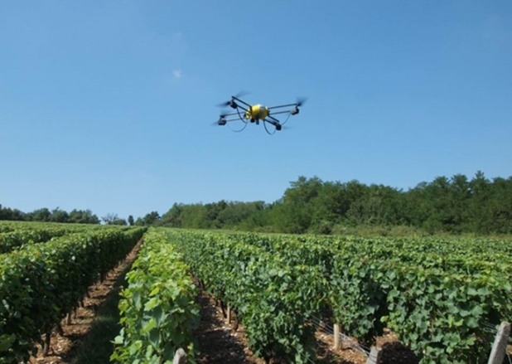
Istraživanja na temu zlatne žutice
Molekularni inhibitori
- blokiraju fitoplazmu prije nego što dođe do stanica
Snimke iz zraka
- primjena dronova s ciljem rane
detekcije simptoma zlatne žutice
unutar vinograda
© INRA
Notes:
Molecular inhibitors
Research is actually ongoing on molecular inhibitors to avoid recognition between the phytoplasma and insect cells. The objective is to block phytoplasma before it reaches the inner cells of the insects. When the insect feeds on an infected grapevine, phytoplasma can be sucked and can infect the vector by passing through several tissue barriers. This phenomenon requires interactions between phytoplasma proteins and insect cell-coat. Researchers intend to block this interaction by inhibiting the protein responsible for the transfer. No results are available at this day.
Air seeking
Early identification of FD symptoms is primordial in FD management. This is why several private and public companies try to develop the use of aerial images taken by drones, aiming at easing the FD management. Researches are still ongoing: at this day, there are no efficient and recognized mean to distinguish FD symptoms from other diseases symptoms using drones.

Slide 21
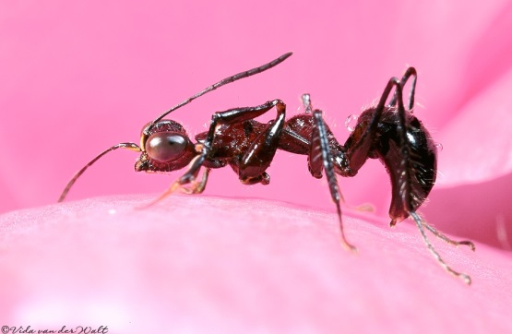
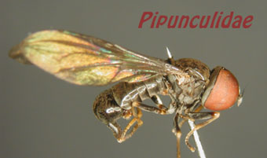
Istraživanja na temu zlatne žutice
Ometanje parenja američkog cvrčka
Budući da mužjaci emitiraju signale (vibracije) kako bi privukli ženku na parenje, primjenom lažnih vibracija pomoću posebnih uređaja može se ometati reprodukcija američkog cvrčka
Na taj se način smanjuje populacija cvrčka iz godine u godinu
Biološka kontrola
Primjena parazitoida koji napadaju američkog cvrčka
Zasad nije moguća šira primjena ove mjere
Anteoninae
Pipunculidae
Gonatopodinae
© Dennis Haines
©kehlmaier.de
Notes:
Mating disruption
An innovative method would be to prevent Scaphoideus titanus populations to grow from one year to another by disturbing its reproduction. The method consists in disturbing signals emitted by males to attract females thus inhibiting their reproduction. Adults communicate with vibrational signals, males have a “call and fly” behaviour and emit a courtship song and females emits signals in responses to males A mechanism broadcasts vibrational signals through a supporting wire and the playback of disruptive vibrational signals reduces the level of male calling and interrupts an established male-female duet. This consequently results in a significantly reduced number of copulations, thus decreasing the population level from one year to another. This method could then be useful to ease long-term management in case of locally high-level populations.
Biological control
Biological control of Scaphoideus titanus population with parasitoids has been experimented, with some Pipunculidae, Anteoninae and Gonatopodinae species but a practical control at a large vineyard scale does not seem possible, even if some of those species are individually able to parasitize Scaphoideus titanus. Biological control is also studied through the use of bacteria disturbing either reproduction or vector’s capacity to transmit the phytoplasma All of these strategies are actually under evaluation and should only be considered as complementary to actual FD fight and cannot replace it.

Slide 22
Zaključci
Zlatna žutica je bolest koja se može brzo širiti, pritom uzrokujući znatne ekonomske gubitke
Iznimno je bitno temeljito provoditi mjere suzbijanja vektora i uklanjati zaražene trsove
Kolektivno suzbijanje zlatne žutice od strane svih vinogradara s određenog područja predstavlja ključ uspjeha
Notes:
Unlike the other vine diseases, management of Flavescence Dorée need to be included in a collective management for which each producer need to use the more efficient tools at his disposal in accordance with the reglementation. The Efficiency of FD management depends on the cohesion between actors. Without control measures, the disease spreads rapidly, affecting up to the totality of vines in a few years. A good management of FD go through a combination of methods working both on the vector, Scaphoideus titanus and on the disease, once grapevines are contaminated by the phytoplasma.

